Slide 1







Technology Trends
Hansel Rodríguez
October 5th, 2022

Slide 2



OUTLINE
Executive Summary
Introduction
Methodology
Results
Visualization – Charts
Dashboard
Discussion
Findings & Implications
Conclusion
Appendix

Slide 3

EXECUTIVE SUMMARY
Web-based languages are the most popular
Use of SQL is still relevant, but there’s an increasing trend in non-relational databases
Machine learning and AI tools and platforms are becoming more relevant
Rapid changes in trends are observed

Slide 4

INTRODUCTION
Technology trends change quickly every year
Analyzing these trends helps software companies to make decisions to remain competitive
Four main areas analyzed:
Programming languages
Databases
Platforms
Web frameworks

Slide 5

METHODOLOGY
Data Sources:
Stack Overflow Developer Survey 2019
Github Job Postings
Programming Languages Annual Salary
Data Wrangling
Exploratory data analysis
Data visualization and dashboard creation

Slide 6
RESULTS

Slide 7
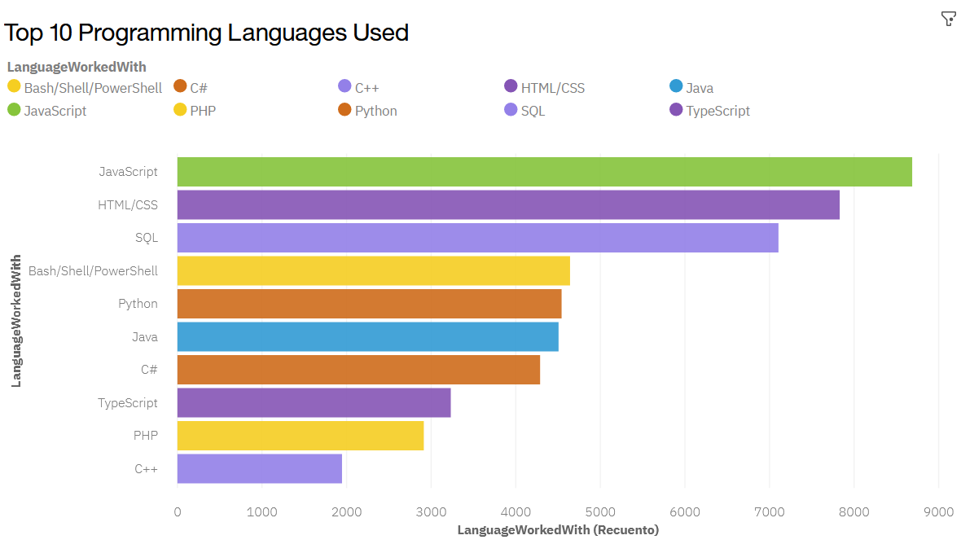
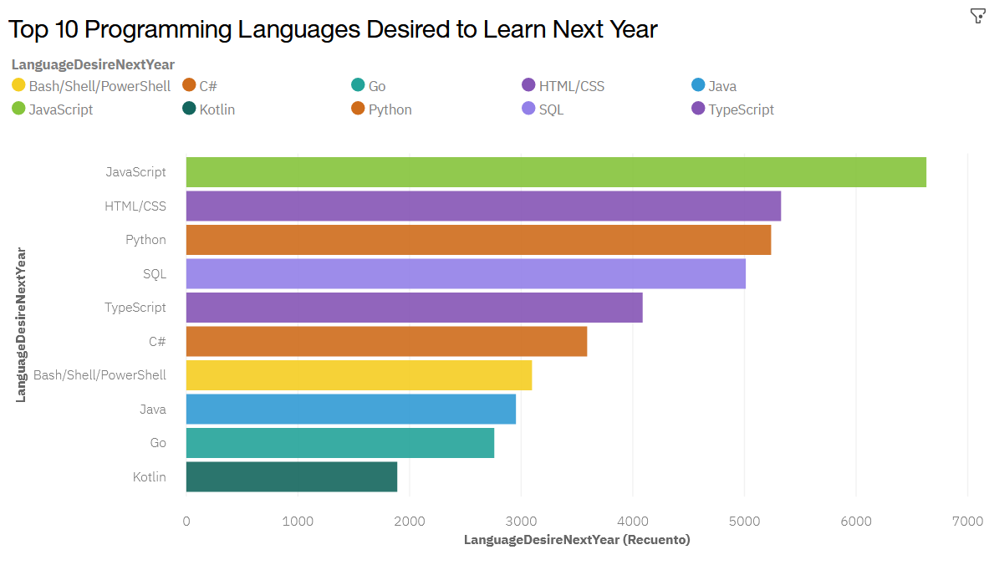
PROGRAMMING LANGUAGE TRENDS
Current Year
Next Year

Slide 8
PROGRAMMING LANGUAGE TRENDS - FINDINGS & IMPLICATIONS
Findings
Javascript and HTML/CSS are the top languages for current and next year
There’s a growing interest in python and typescript
Decreased interest in SQL, java, C# and bash
Implications
High interest in web development
Growing interest in data science and machine learning tasks
SQL is still required for companies

Slide 9
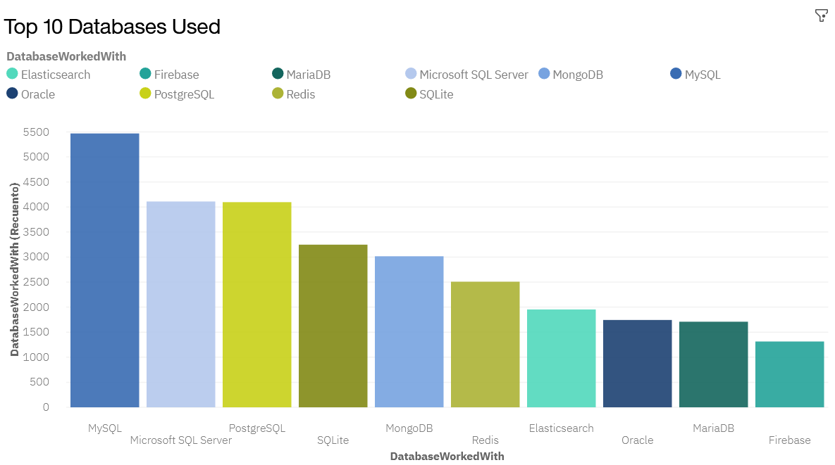
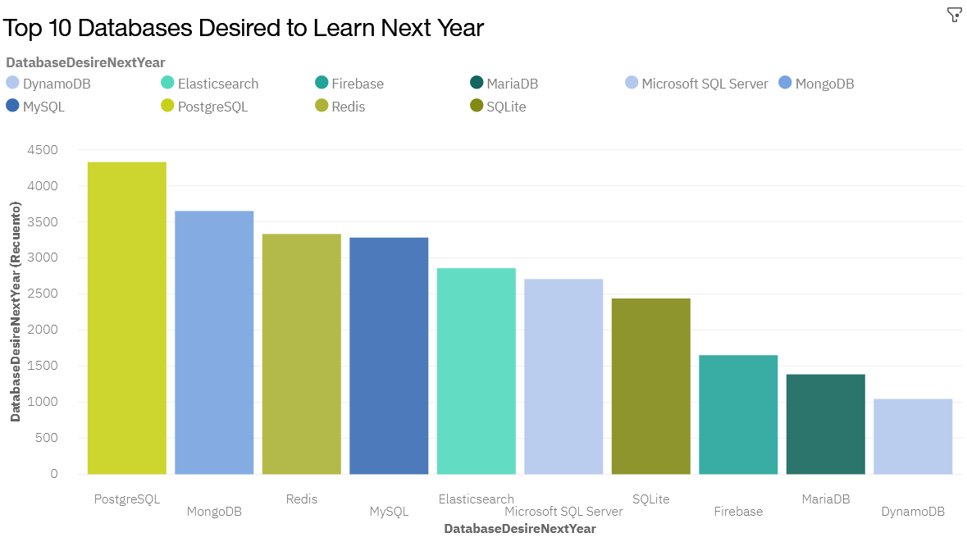
DATABASE TRENDS
Current Year
Next Year

Slide 10
DATABASE TRENDS - FINDINGS & IMPLICATIONS
Findings
Quick rise of PostgreSQL, MongoDB and Redis to the top for next year
Decreased interest for MySQL and Microsoft SQL Server
Oracle disappeared from Top 10 for next year
Implications
Preference for open source databases
NoSQL databases are becoming more popular
SQL databases are still required at companies

Slide 11

DASHBOARD
IBM Cognos Analytics Dashboard

Slide 12
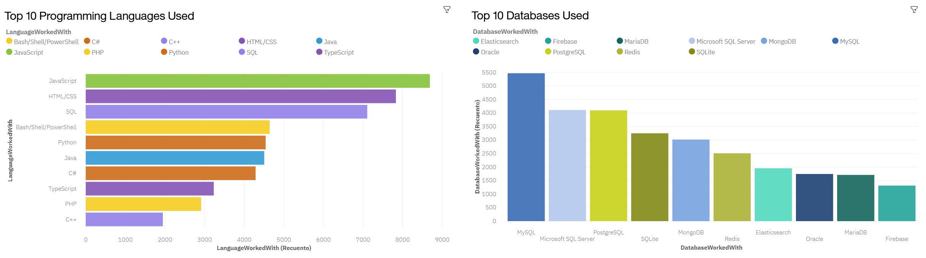
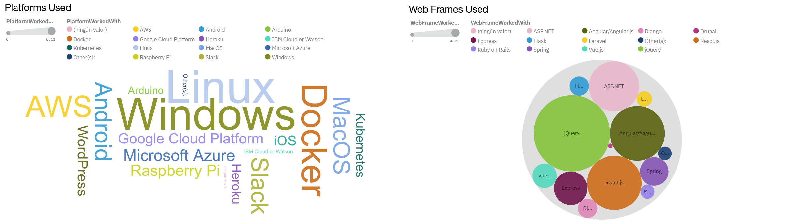
DASHBOARD TAB 1

Slide 13
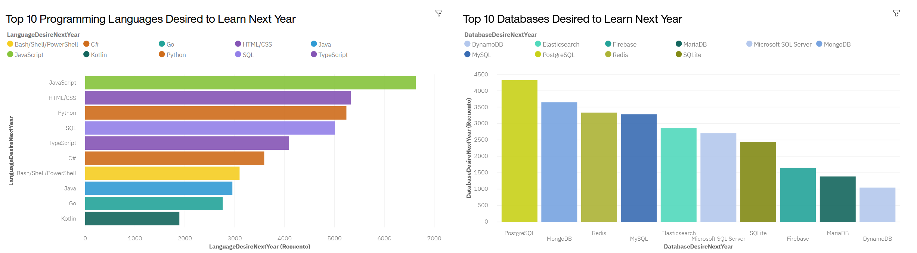
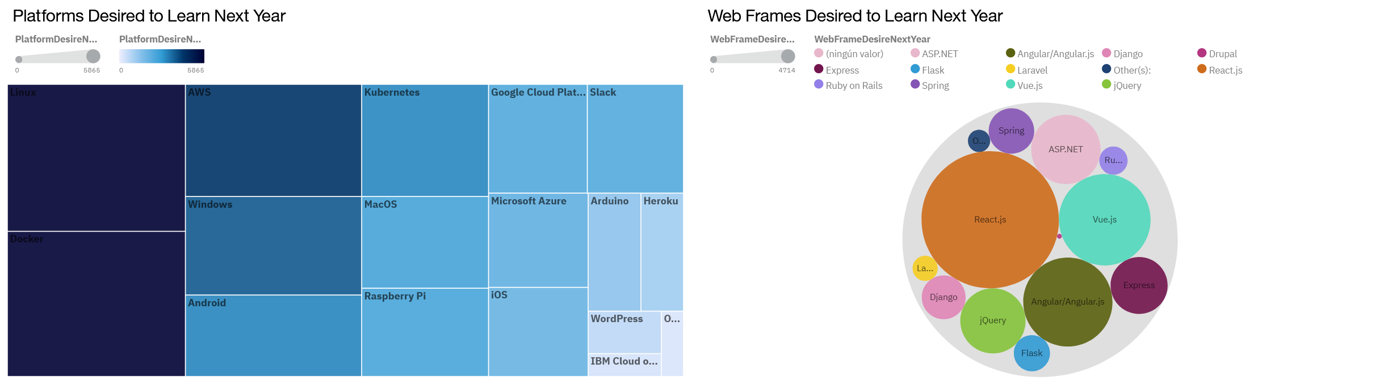
DASHBOARD TAB 2

Slide 14
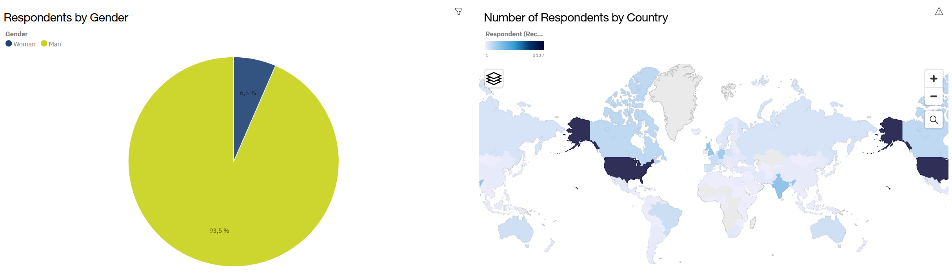
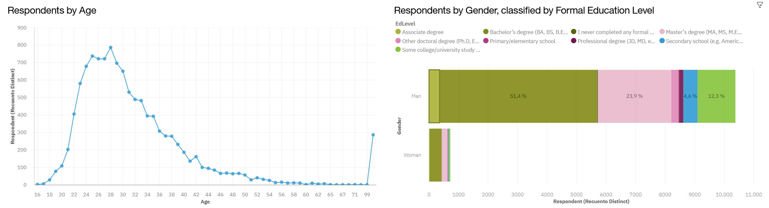
DASHBOARD TAB 3

Slide 15
DISCUSSION

Slide 16
OVERALL FINDINGS & IMPLICATIONS
Findings
Most of the respondents are men between 20 and 30 years old, with a bachelor’s degree living in the USA
Cloud platforms use is growing
Interest in jQuery decreased for next year
Interest in Vue.js increased significantly for next year
Implications
Web based applications development is taking over desktop applications development
Companies need to be flexible to changes
Huge gender gap in IT jobs

Slide 17

CONCLUSION
Web-based languages and non-relational databases are becoming more and more relevant
There’s a need to reduce the gender gap in IT jobs
Learning python and use of cloud platforms is needed for machine learning and AI development

Slide 18

APPENDIX

Slide 19
JOB POSTINGS

Slide 20
JOB POSTINGS

Slide 21
POPULAR LANGUAGES

